Slide 1
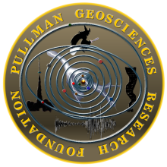
The Glenda Project
The Glenda Project
Developers of the Thunderocket™ Weather Research Series of rapid deployment payload delivery vehicles, since 1997
Multi-Dimensional Data Modeling Tornado Prediction®™
EMF Spectral Mapping Process and Identification of Tornado Signatures Systems®™
Celebrating 17 Years of Award Winning Research and Development 1997 - 2014
Coastal Thermal Generators
of
Tornadoes

Slide 2
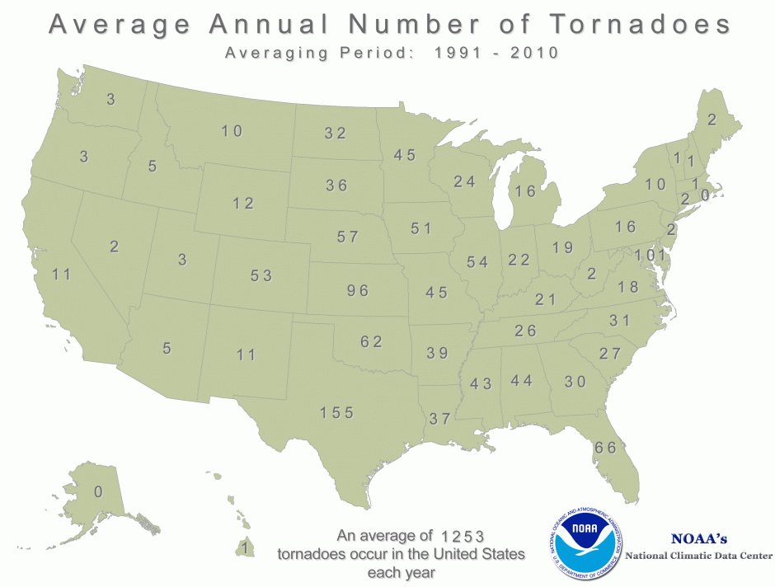
Annual Average Number of Tornadoes
http://www.ncdc.noaa.gov/climate-information/extreme-events/us-tornado-climatology

Slide 3
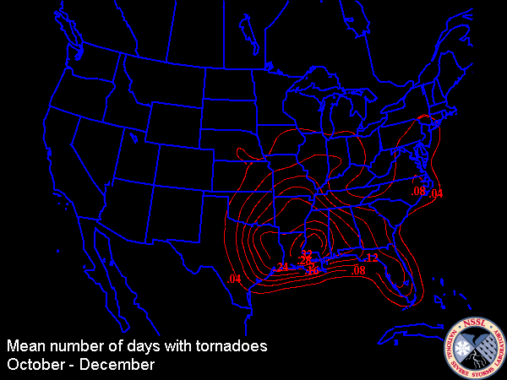
Dixie Alley
Bayou Canada Weather Center is in Dixie Alley
Source: http://www.ncdc.noaa.gov/file/1536

Slide 4
Satellite Air Thermal Map
(Typical Day December 17 2013) Looks Calm

Slide 5
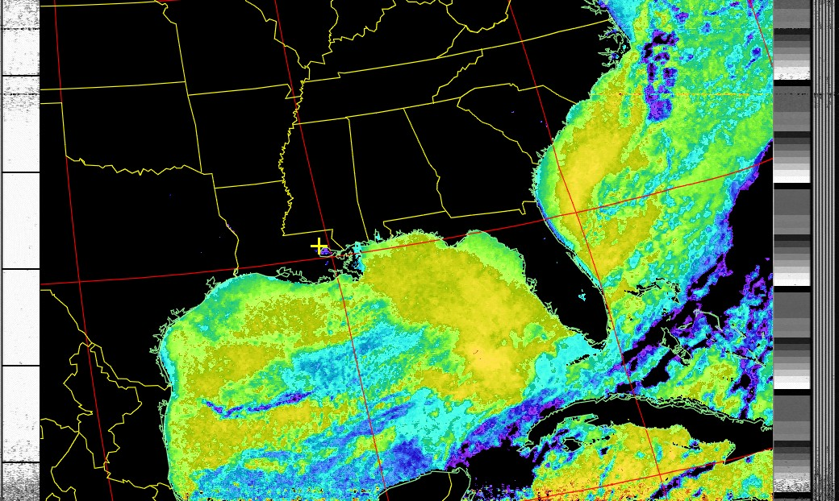
Satellite Water Thermal Map
Examine South Louisiana Delta Coast
(Typical Day December 17 2013) Fresh Water Entering Gulf Cools Coast Areas

Slide 6
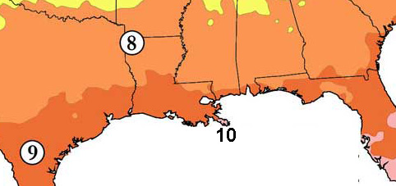
Climate Growing Zones
Growing Zones Reflect Land vs Water Interaction

Slide 7
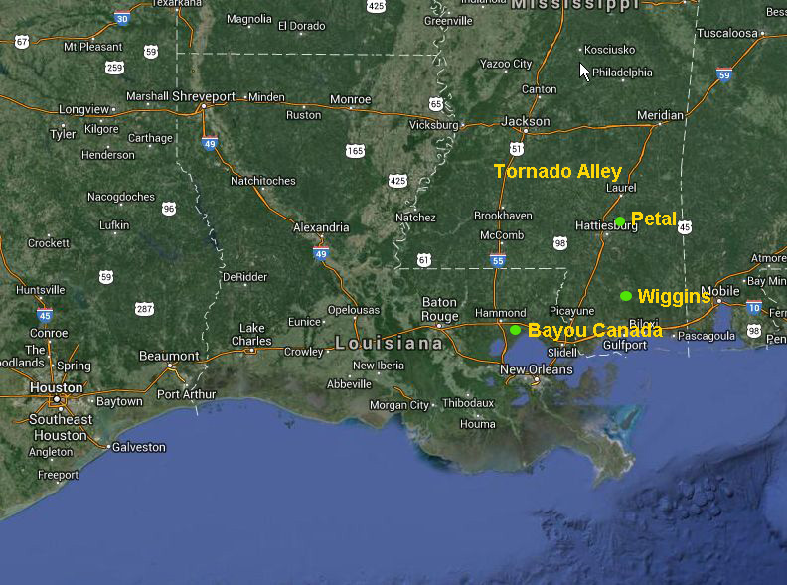
Regional Map
Layout of Major Players

Slide 8
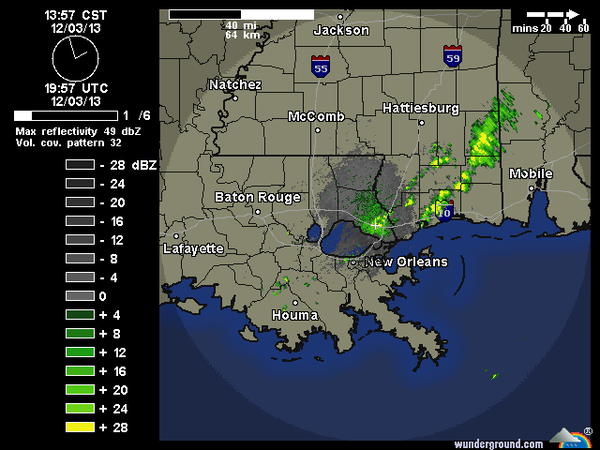
December 3rd Weather Setup
In Past Tornadoes Have Tracked Houma to Wiggins

Slide 9
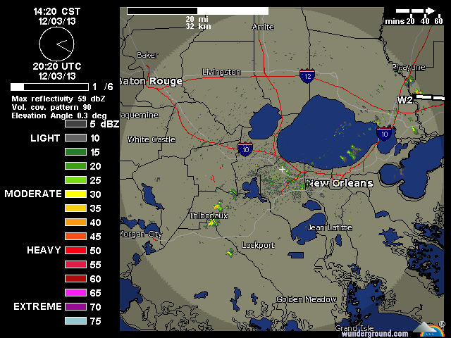
Identification of Thermal Stream
HD Radar View of Path To Wiggins

Slide 10
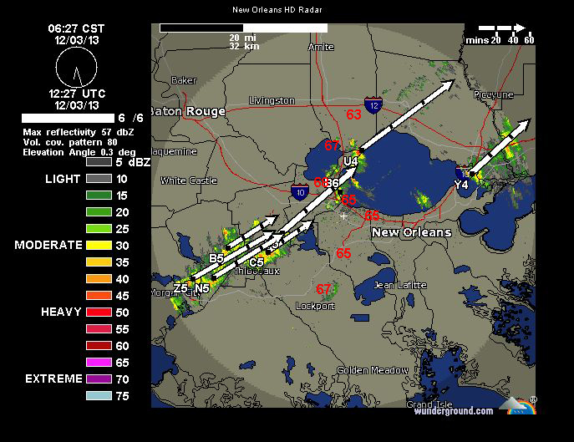
Early Morning Location
Temperatures Cross Section

Slide 11
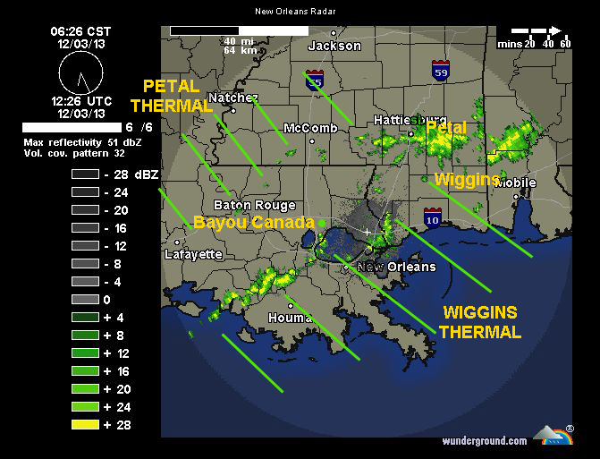
Thermals Identified
Petal Thermal Originates Near Houston
Wiggins Thermal Originates Near Houma

Slide 12
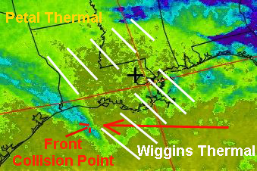
Add Cold Front To the Mix
Cold Front Approaches at Right Angle to Thermals (Spin)
Energy Levels in Right Amount Cause Water Funnels
On Land Energy Levels in Right Amount Create Tornadoes

Slide 13
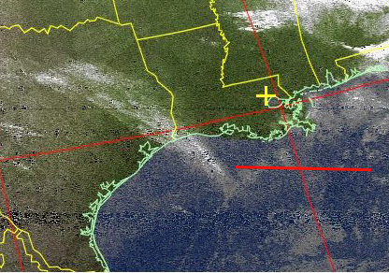
Satellite View of Front
Thermal Barely Visible on Satellite Image

Slide 14
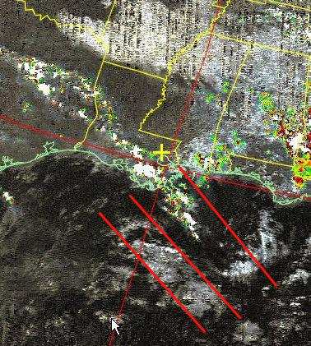
Front Progression East Thermal Moves
Thermal Over Water Energizes

Slide 15
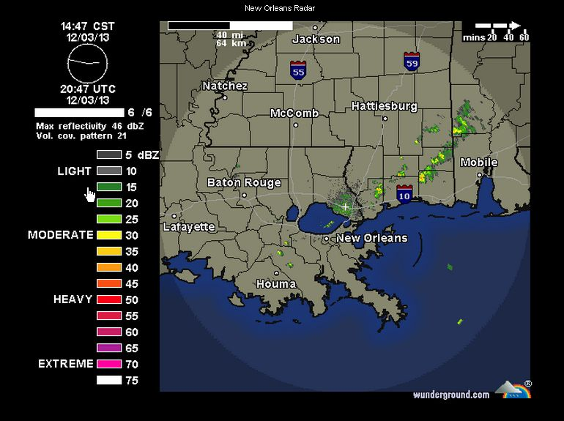
Thermal Changes Location Over Land
Slight Movement = More Moisture From Swamps

Slide 16
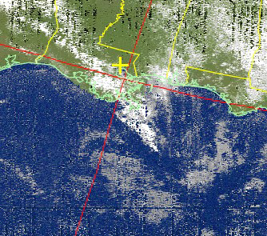
Front Energizes
Front Picks up Energy from Swamps

Slide 17
Firing The Tornado
The Energy of the Thermal must be high enough to stay intact as front passes overhead
If Thermal stays strong and Front movement is fast Tornadoes will Spawn
RH, Temp and Baro Parameters in Place Verifies Generator Will Fire
If Thermal stays strong but Front movement is slow there may not be sufficient energy to fire
Petal and Wiggin Thermals may fire independently
Thermals may move up or down in flow but will track within a general zone – hence local Tornado Alley valid concept
Coastal Climate Zones May influence localized Tstorm and Tornado Development

Slide 18
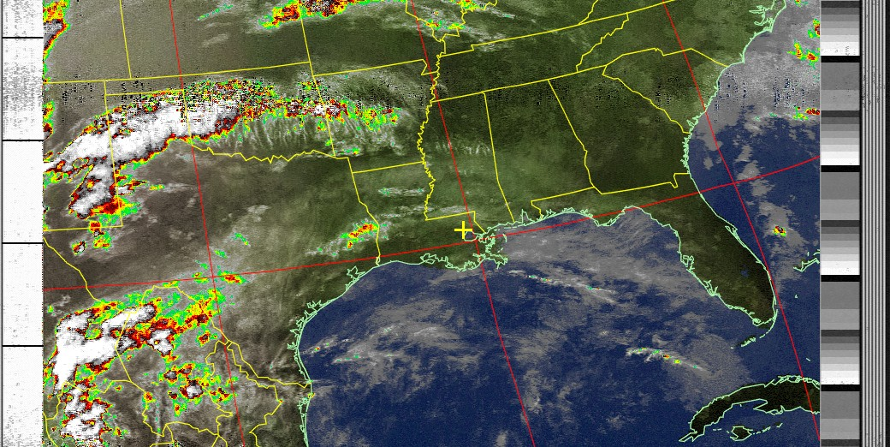
Front Passage
Tornado Alley’s can stretch into Alabama with either Thermal Generator – Hence the Chase Need
If Energy Missing Front Passes With No Tornadoes

Slide 19
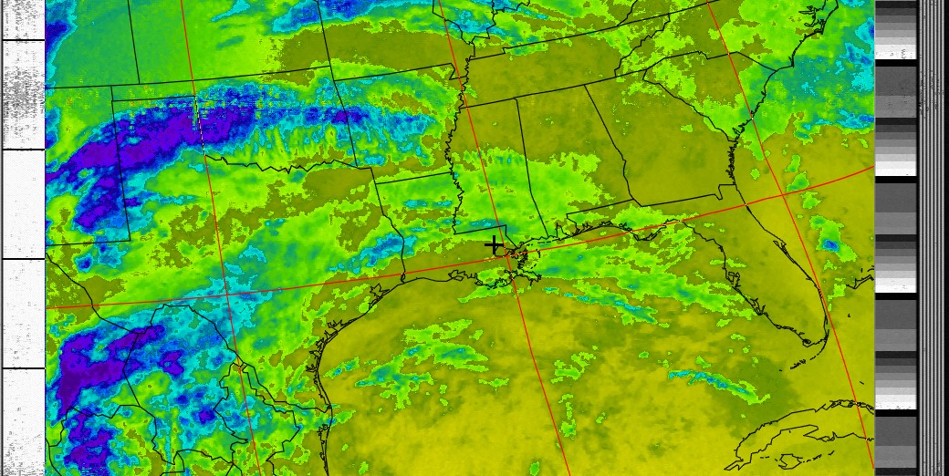
Thermal Influence Continues
Even as front moves East Wiggin’s Thermal Still Influences Local Weather Temps

Slide 20
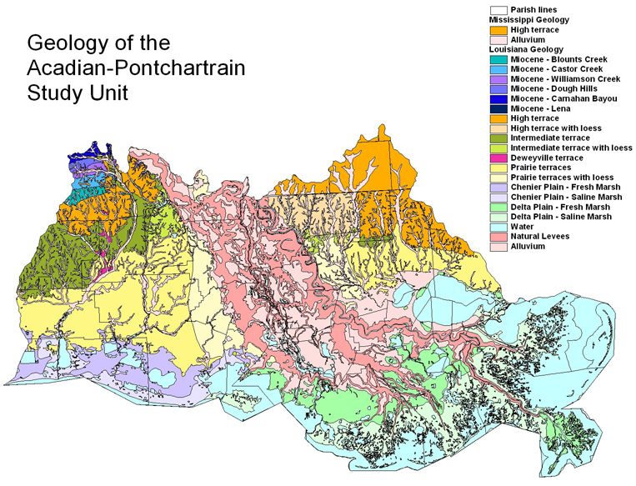
What Creates The Thermal?
Is it the Geology?

Slide 21
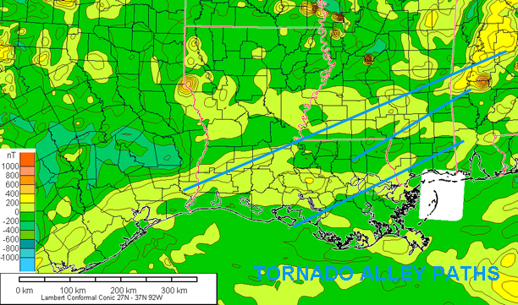
Gravity and Magnetic Map
Thermal Paths Match Map Zones

Slide 22
Conclusion
There appears to be a direct correlation between the paths of the Tornadoes and the Gravity/Magnetic Patterns of the Locale
The edges of a GeoMag Zone can create a continuous Thermal Flow in the Atmosphere
Magnetic Zones can aim the Tornadoes
The interaction of the Thermal Flows with Atmospheric Energy can fire the Generators

Slide 23
Contact Information
Pullman Geosciences Research Foundation
http://pullmangeosciences.org
Glenda Project
http://glendaproject.org
Email:
bayoucanada@pullman.net
Copyright 2013 Pullman Geosciences Research Foundation All Rights Reserved

Slide 24
Summary

